Slide 1
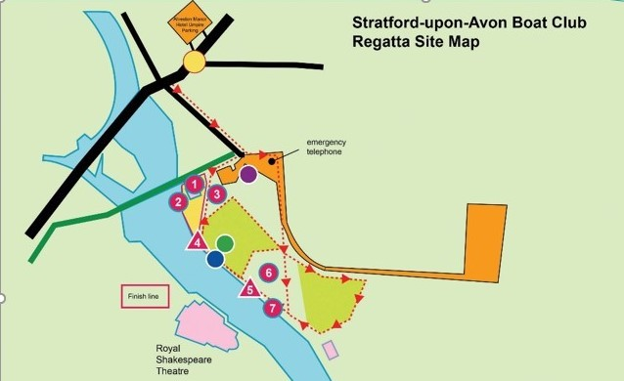
Umpire Parking
Boathouse
Area
Registration & Regatta Control
Toilets including Disabled Facilities
Trailers follow broad Red Arrows
Trailer Parking
Public Car Parking
First Aid
Boats Off
Finish Tent
Commentator Position
Boat Pairing
Umpire staging
Boats On

